Slide 1
Jungle
By Eric Becker, Jason Bae, Brendon Edward Rouse, Ammiel Maynard, and Juan Barraza.

Slide 2
Meet our team
Eric Becker : Team Lead, Backend SQL Developer
Juan Barraza : Middleware Developer
Jason Bae : Front End Developer
Brendan Rouse : Front End Developer
Ammiel Maynard : Front End Developer

Slide 3
Overview
Shopping Web Application
Purchase Item
Check inventory
Look up your account
Look at your cart

Slide 4
What did we use
Languages
SQL, JavaScript, CSS
Framework
React, ASP. Net, Rest API, Azure, Bootstrap, Swagger
IDE
Microsoft SQL Server, Visual Studio, Visual Studio Code

Slide 5
Back End Development
Transforming Data

Slide 6
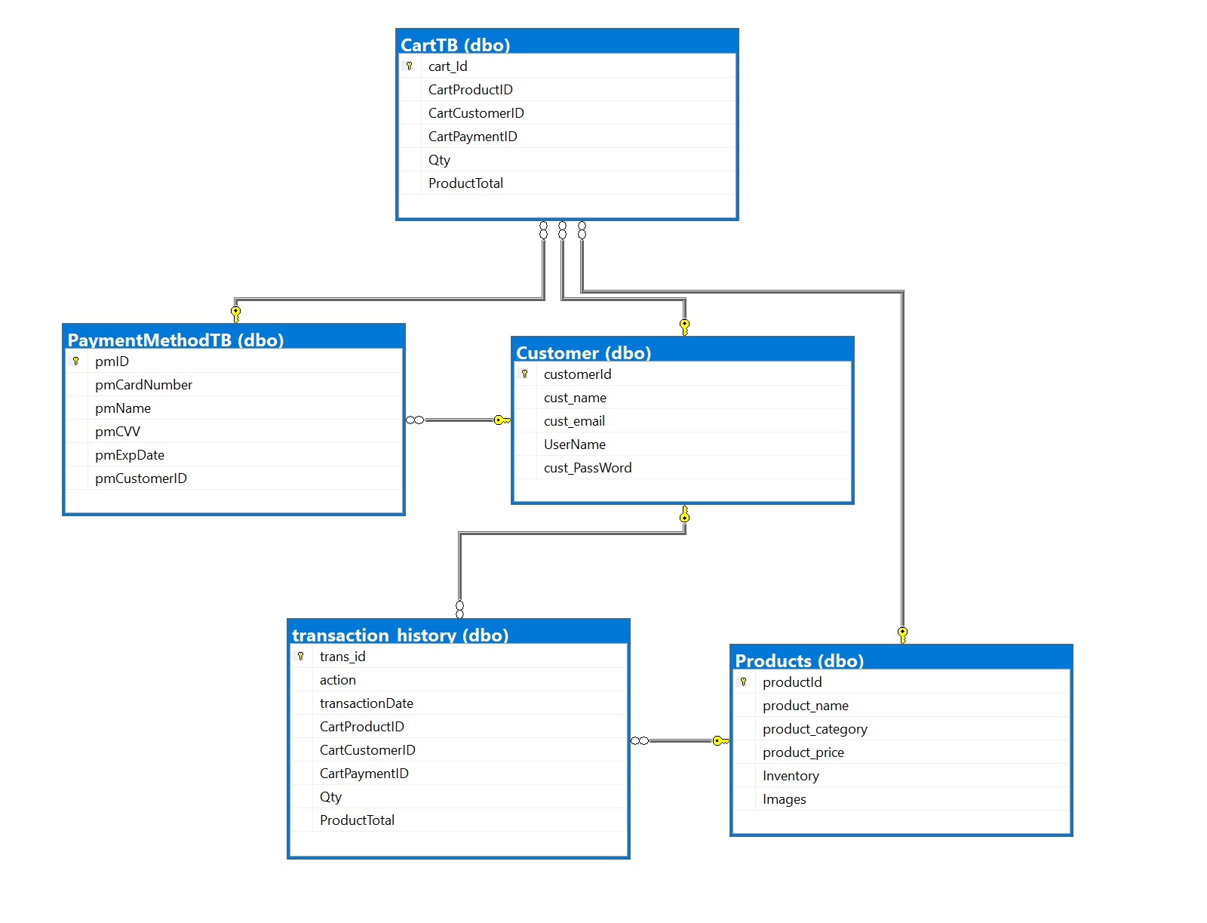
What we made
5 tables
Cart
Products
Customer
Transaction History
Payment Method

Slide 7

Mechanisms within the database
Triggers
For insert: Will add a record to the transaction history after a shopping cart record is made
After insert: Subtracts quantity from Product table when you add a quantity to the shopping cart table

Slide 8
Middleware
Let’s meet in the middle

Slide 9
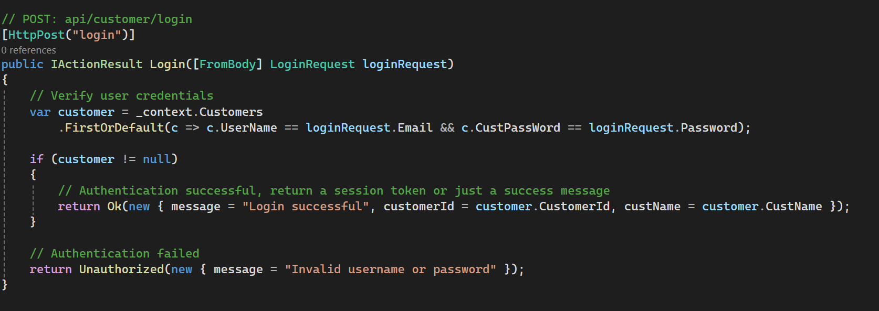
What we did
Scaffold backend data that we developed from SQL Server Management Studio, so that we can create Controller for each table
Included Additional functions to fulfill requirements of Frontend
Swagger to develop and describe REST API

Slide 10
Front - end
Front and Center

Slide 11
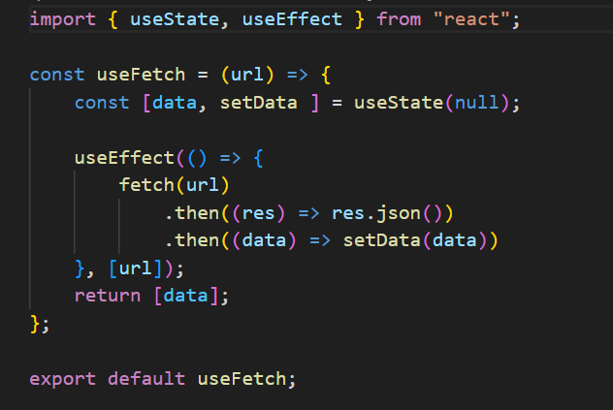
Overview
Frontend Requirements
Display Products
Authentication
Filtering (Search, filter through product list)
Cart Operations (Adding Products, Remove Products)
Display Account Information
Beautify Frontend (Bootstrap)
Concepts Utilized
Functional Component
Hooks (useState, useContext,useEffect, Custom Hooks, etc.)
Bootstrap (Card, Navbar, Button, Form, Container, Alert, Grid, Modal, NavDropdown)
Routing (Link, Error Page)

Slide 12
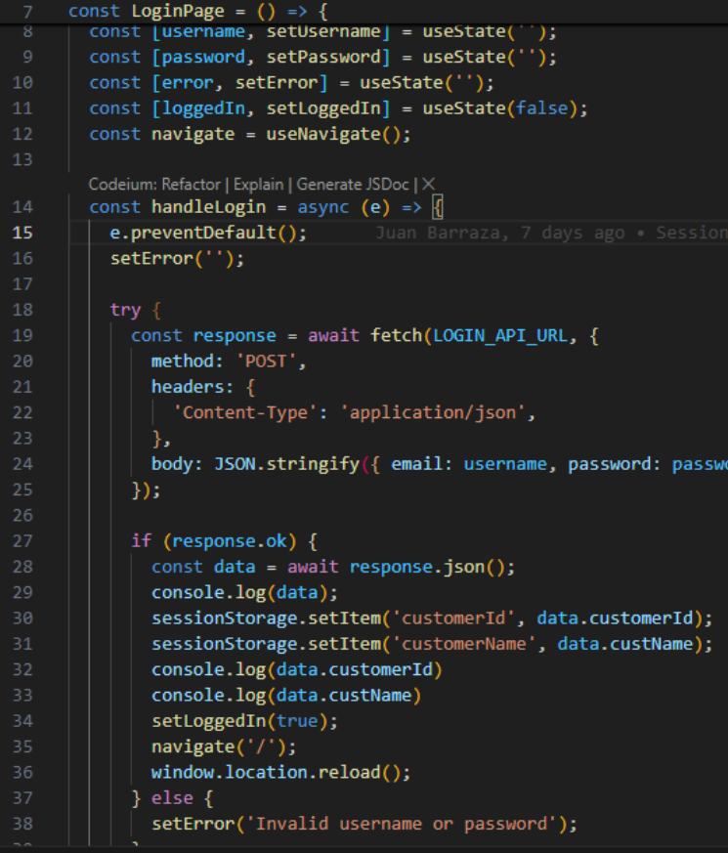
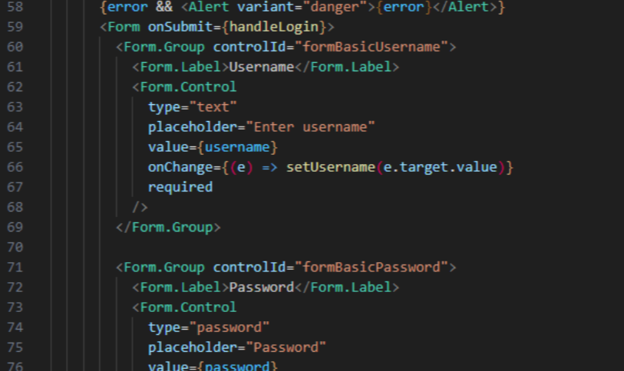
Login Credential

Slide 13
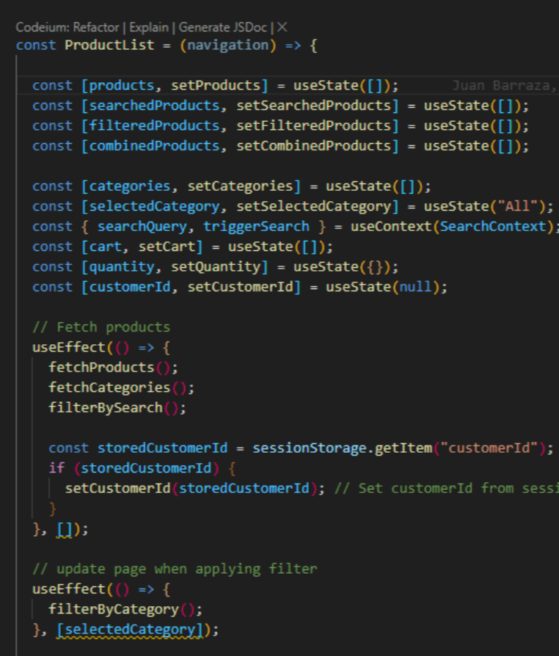
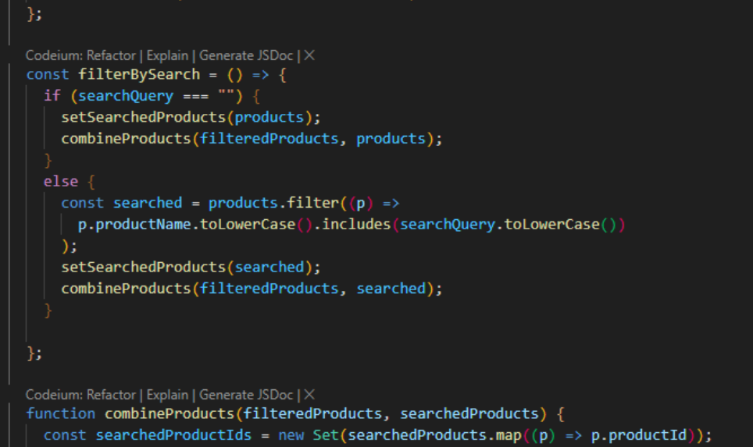
Make a slide for Product/Product Detail/Cart information

Slide 14
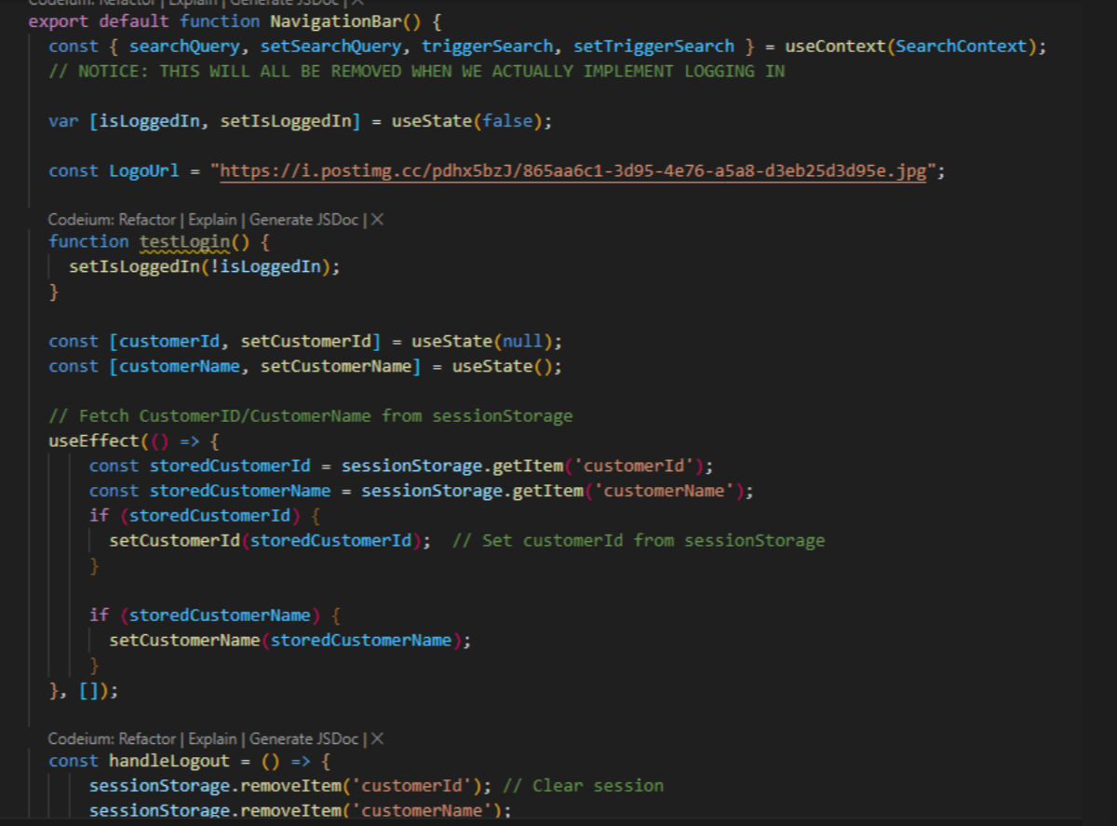
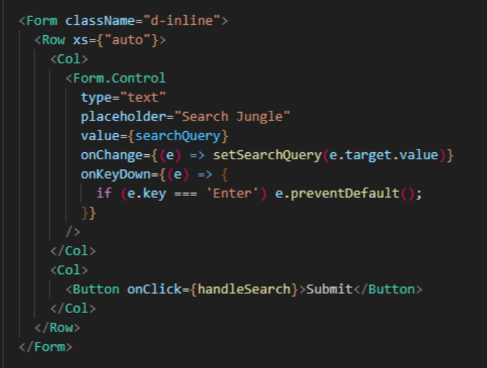
Make a slide for Search capability

Slide 15
Future Consideration
We would like to add more error-handling cases
Add a final purchase page
Making a review page
Adding a subscription
Jungle Video

Slide 16
Thank you
Eric : edbecker1819@gmail.com
Jason : jason782@revature.net
Ammiel : ammiel784@revature.net
Juan : juan798@revature.net
Brendan : brendanedward754@revature.net

